Slide 1

WhatsDown
Made by Sakka Mario,Mahmoud Abdelrahman
Group:1211EB

Slide 2
INTRODUCTION.
2023
How did it all start?
We wanted to create a chatting app that we would actually use, which would not expose our private data to big tech companies.

Slide 3



Content:
the programming languages we used to implement the application
Aim of the Application
Comparing similar applications to our own app
New features on the website
2020

Slide 4
What languages did we use?
HTML
CSS
JS
PHP
MYSQL

Slide 5
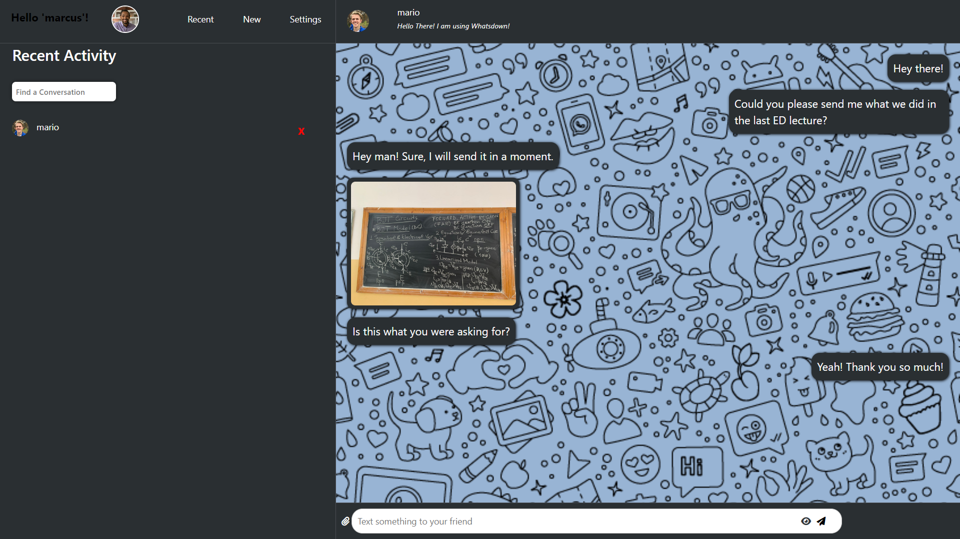
Our app

Slide 6
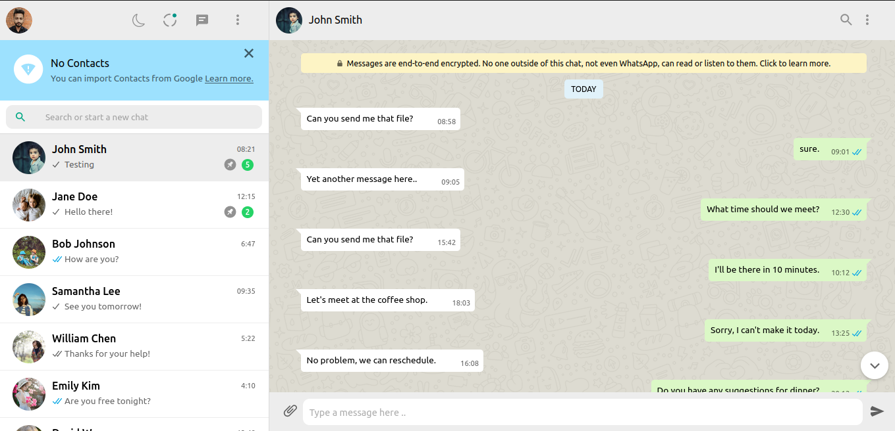
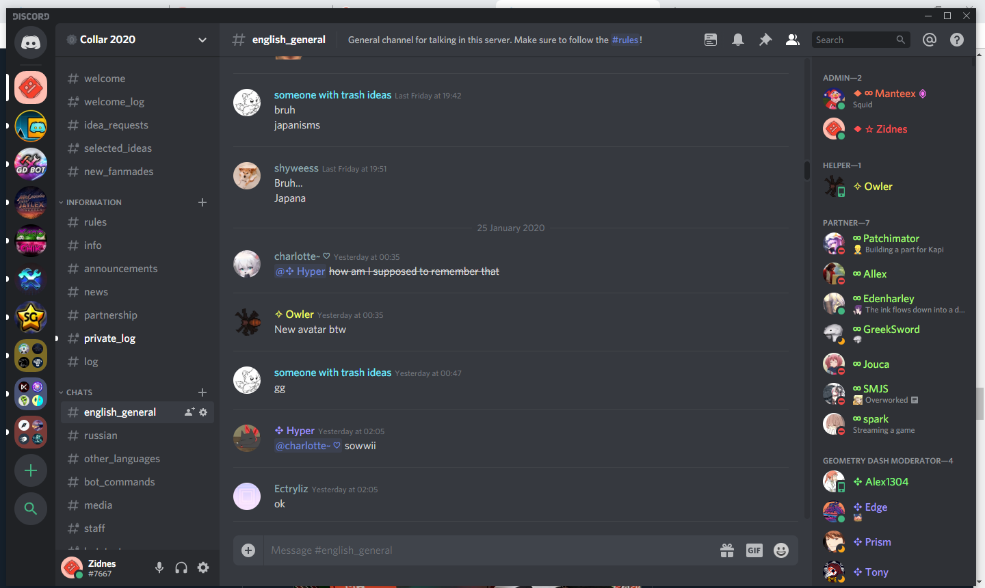
Similar apps:
Whatsapp
Discord

Slide 7

What’s different from the others?
And improved.
01
02
03
Hidden messages
Personalized settings
Customizable Wallpaper
You can send text messages and images whose contents are hidden unless you click on them
You can change the style of chats the way you want
The background can be whatever you want!

Slide 8
Objectives:
Instant Messaging:
ACCESSIBLE TO EVERYONE
Encourage people to stay connected
Multimedia Messaging
International communication
privacy

Slide 9
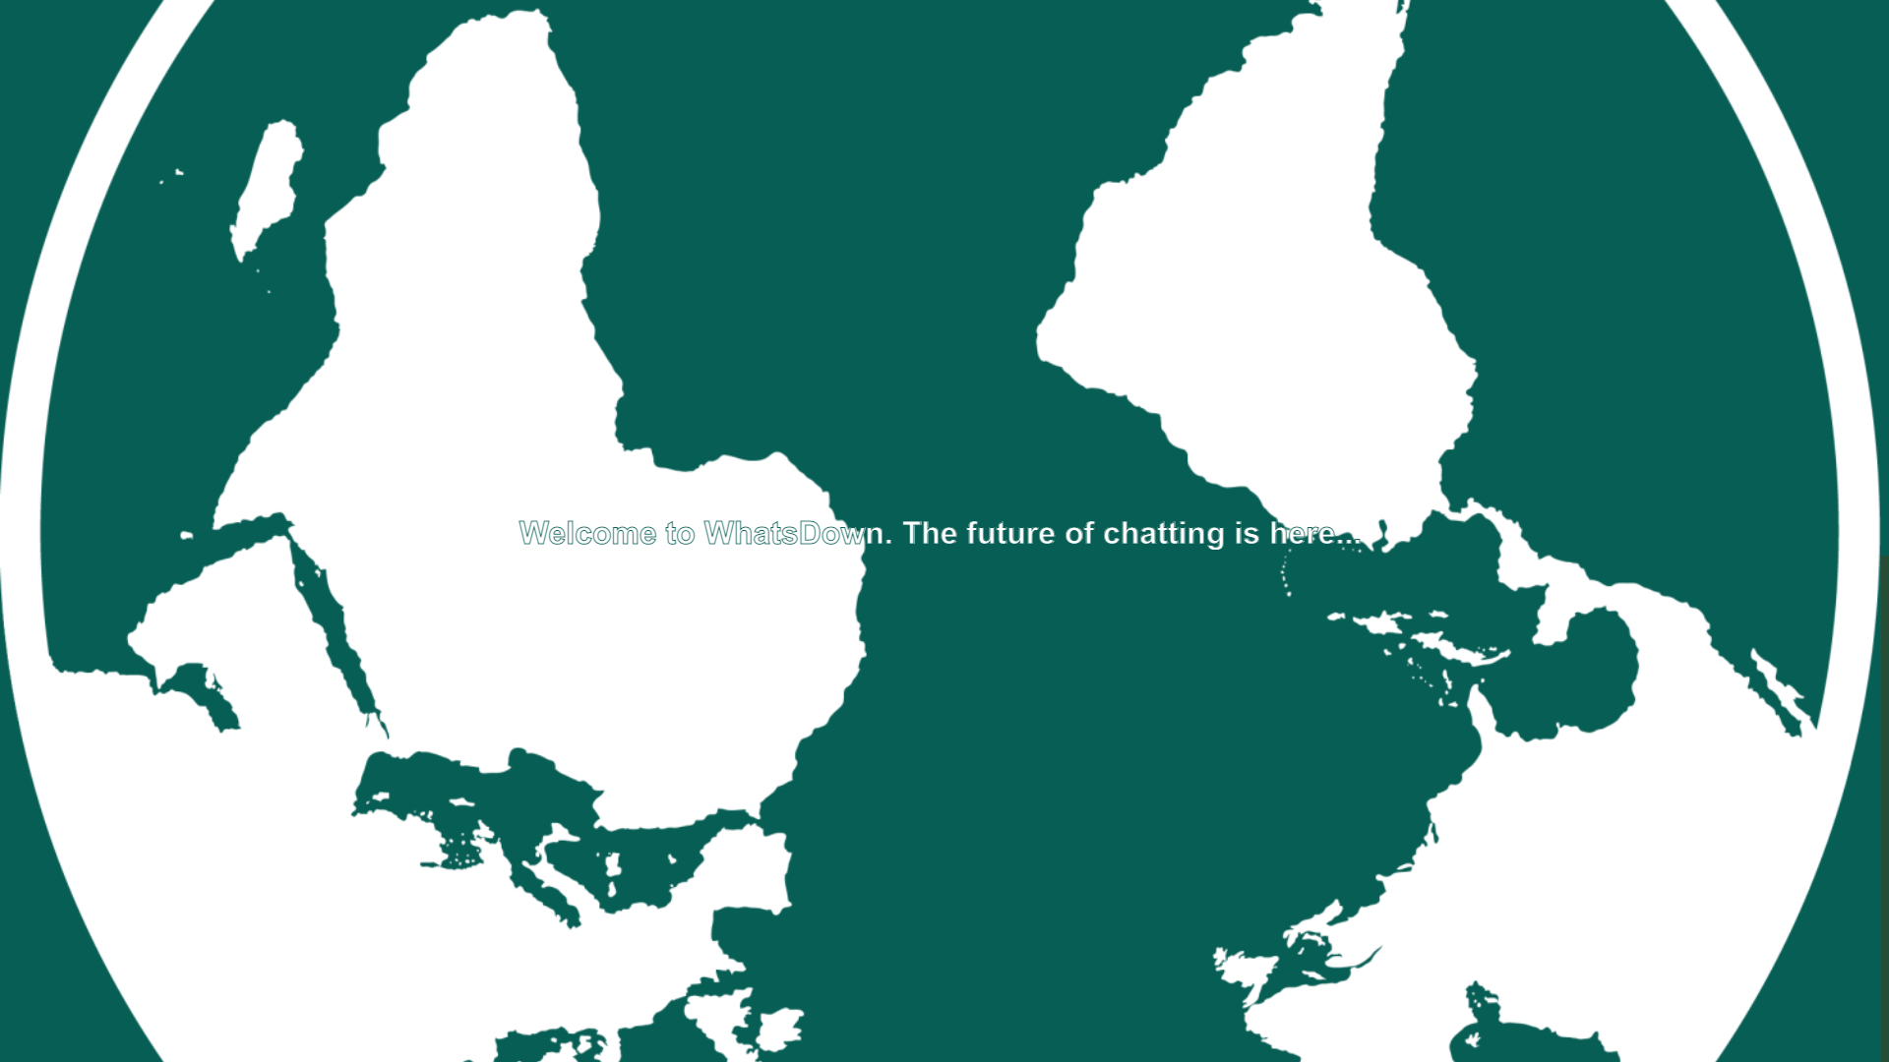

Slide 10
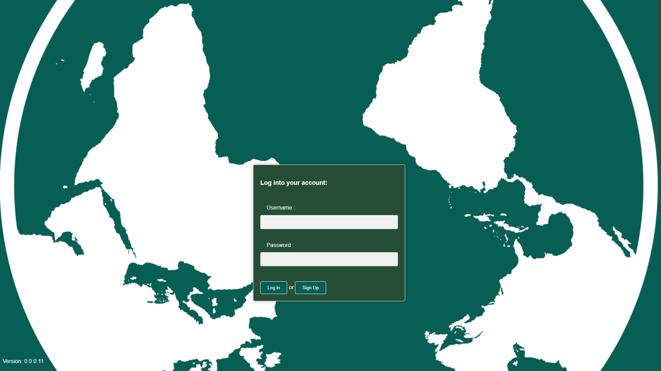

Slide 11
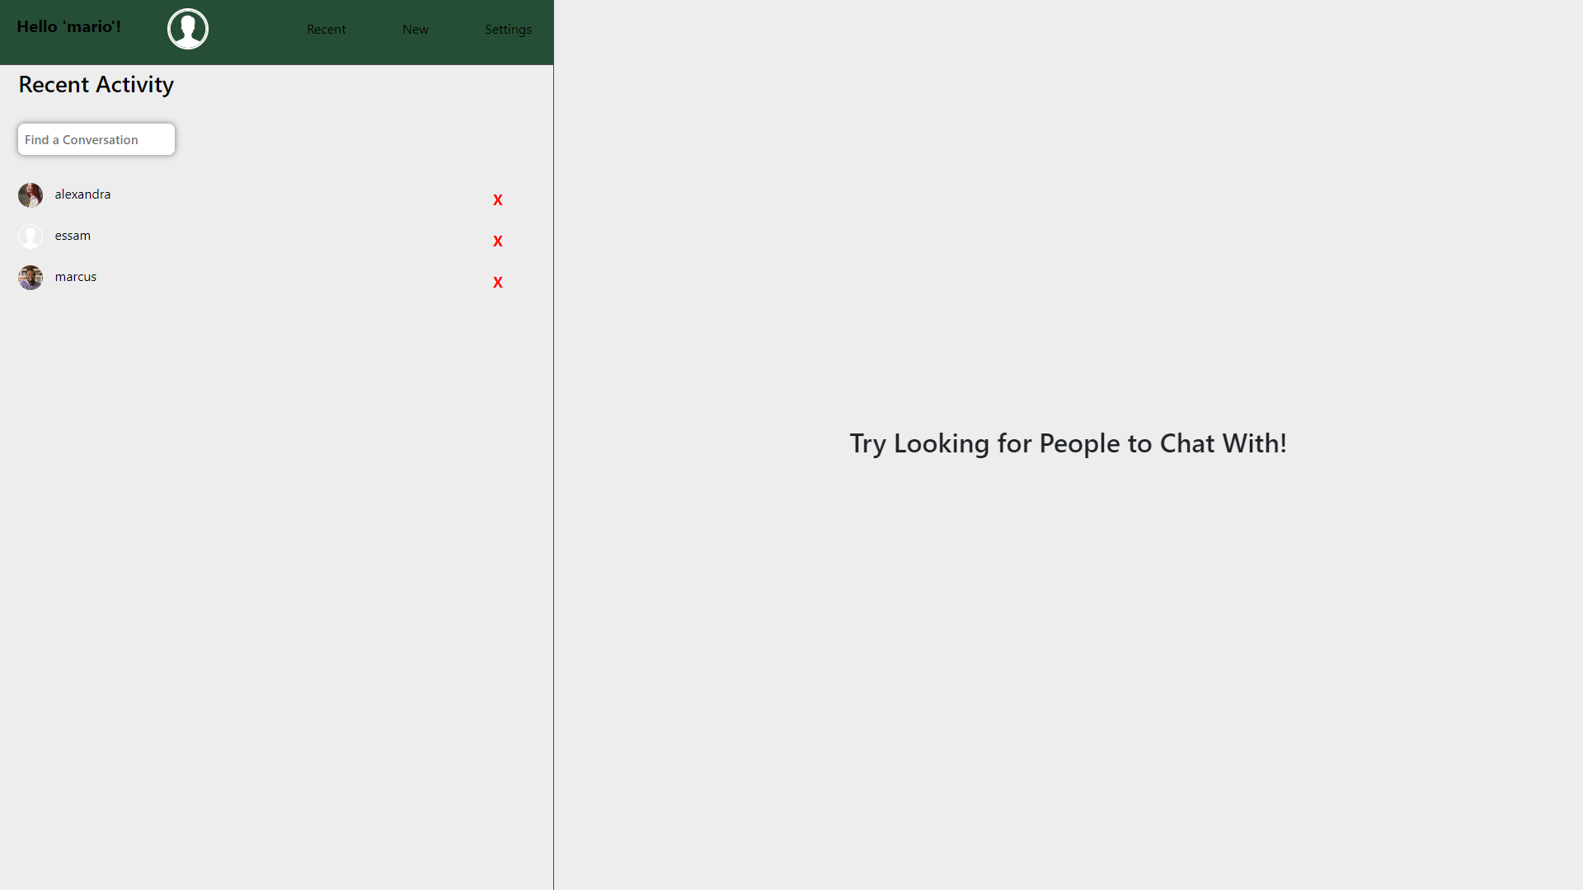
Home Page

Slide 12
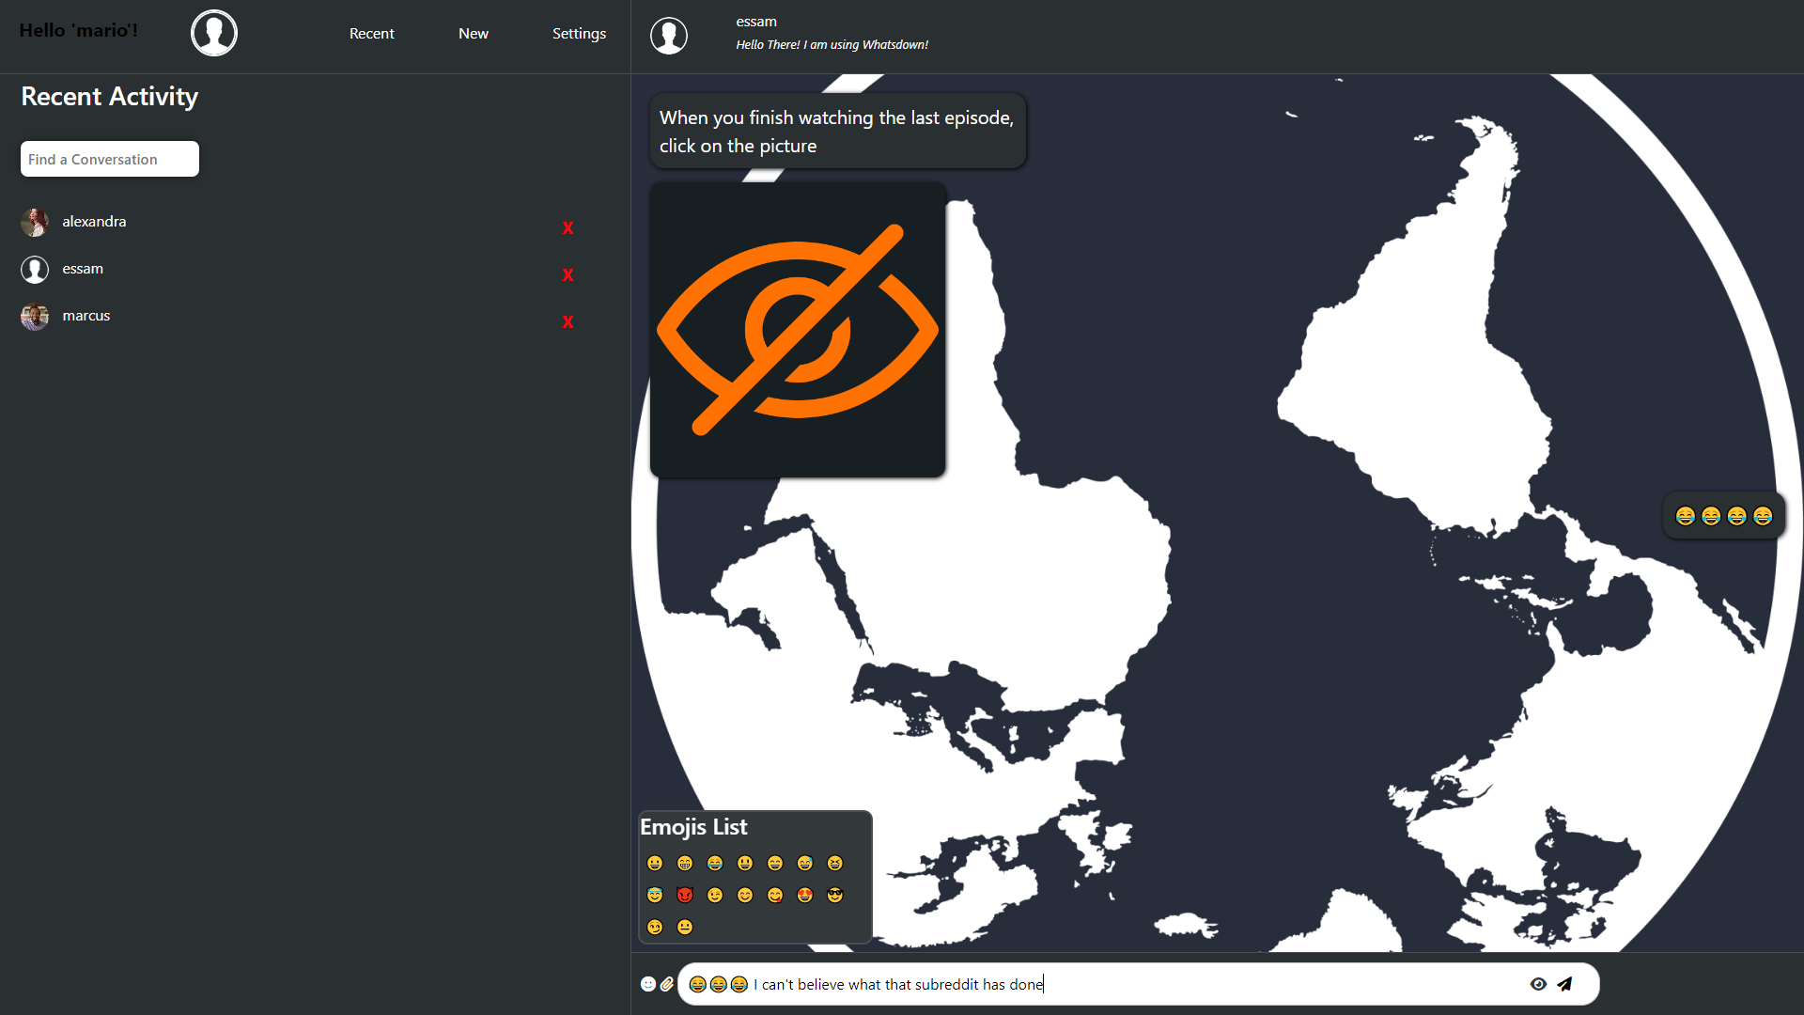
Chatting:

Slide 13
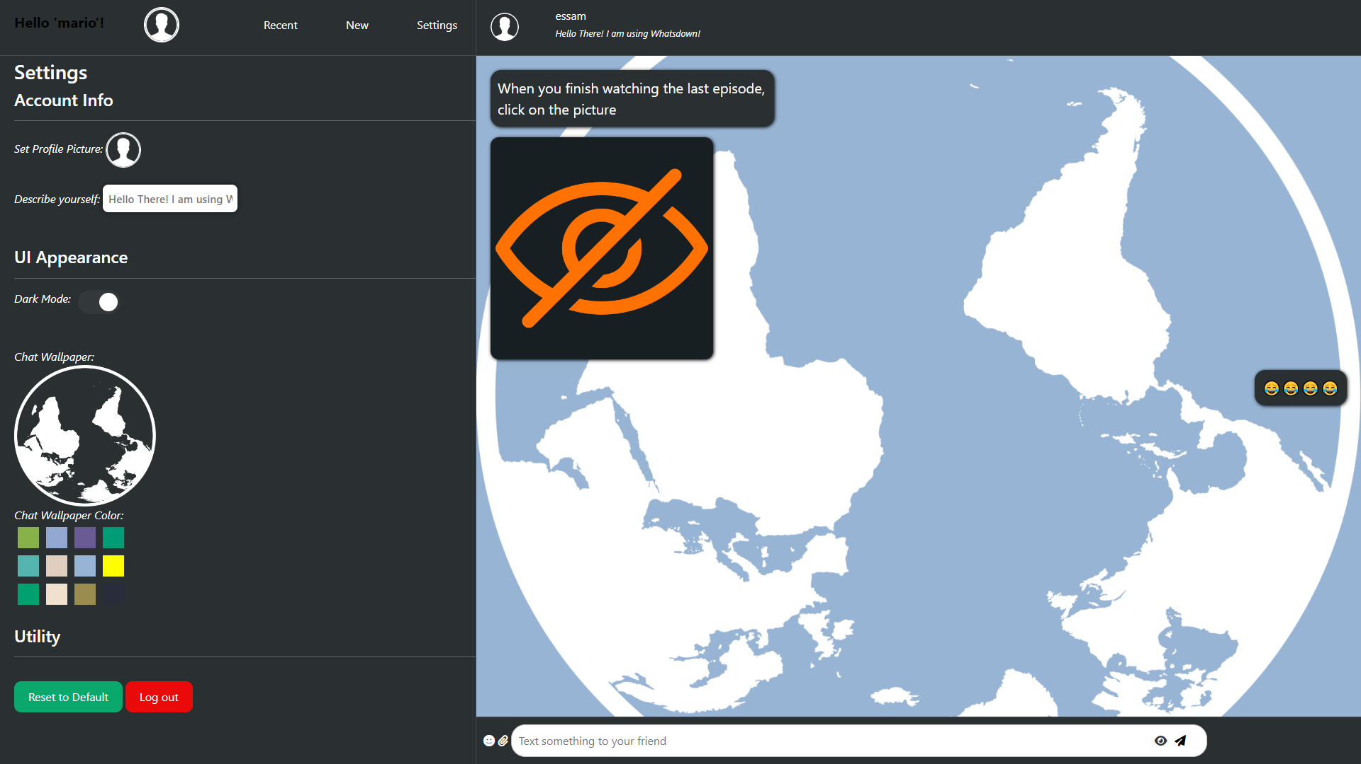
Personalization:

Slide 14
Group chats
You can talk with 3+ friends in one chat
What’s Next?
Blocking users
And more..
Pinned messages
Pinning important messages to find them quicker

Slide 15
Thank You.

